Slide 1
FowlerSite

Slide 2
Introductions
Michael Voorhies
Casey Adams
Anthony Ganster
Dominic Perrine

Slide 3
What we did
Casey – Worked on back-end composition and helping other team members. Data injection for the database.
Michael – Worked on the login page for users and admins.
Anthony – Home page cleanup and a (mostly) functional filter.
Dominic – The cart and store functionality.

Slide 4
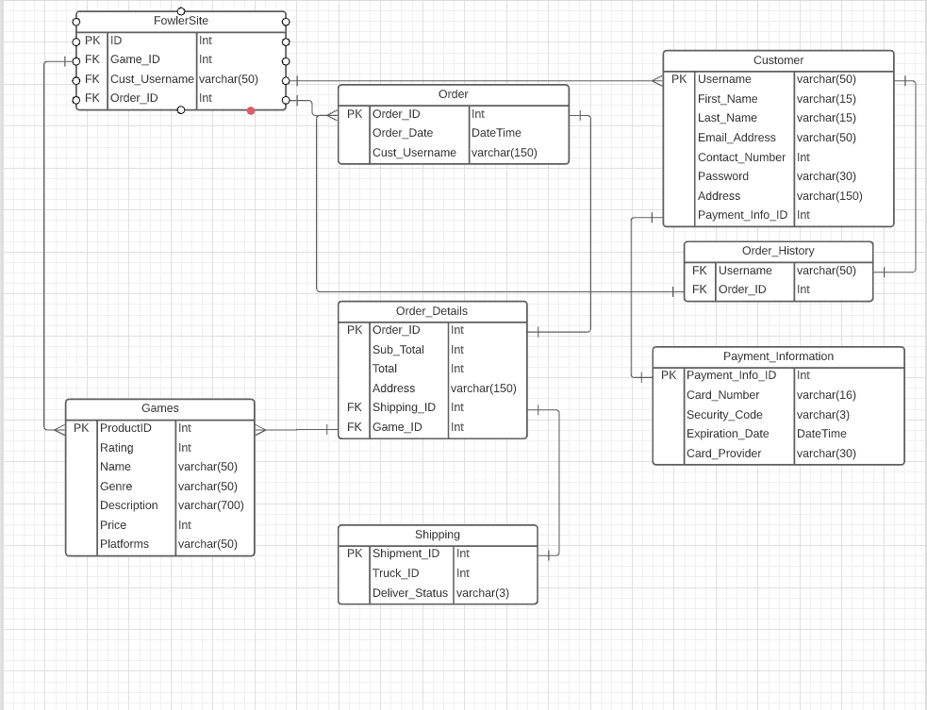
ERD

Slide 5
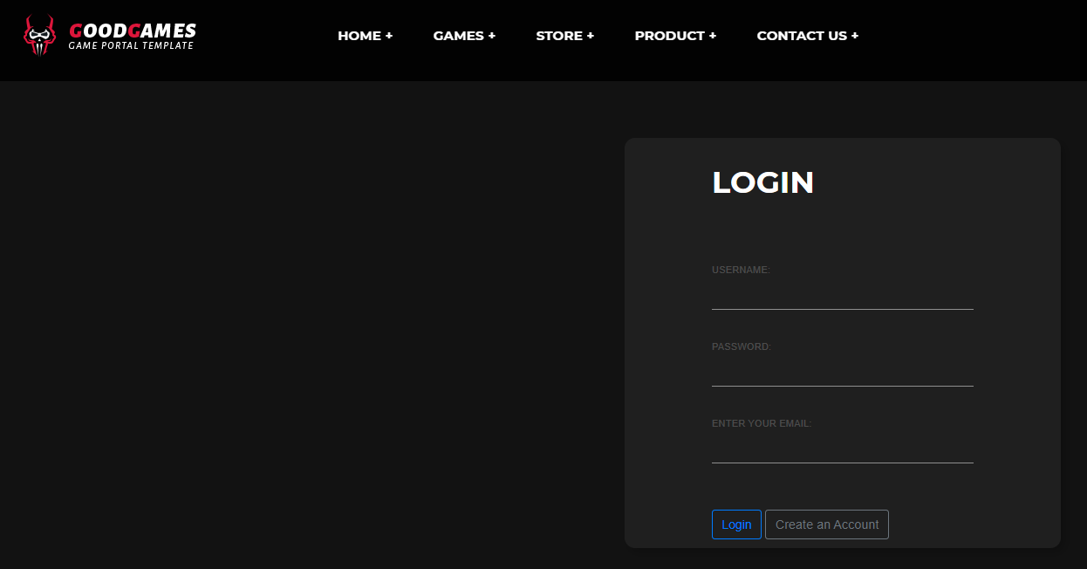
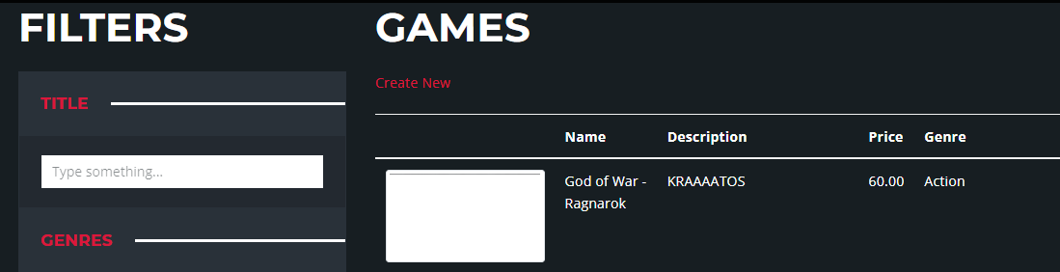
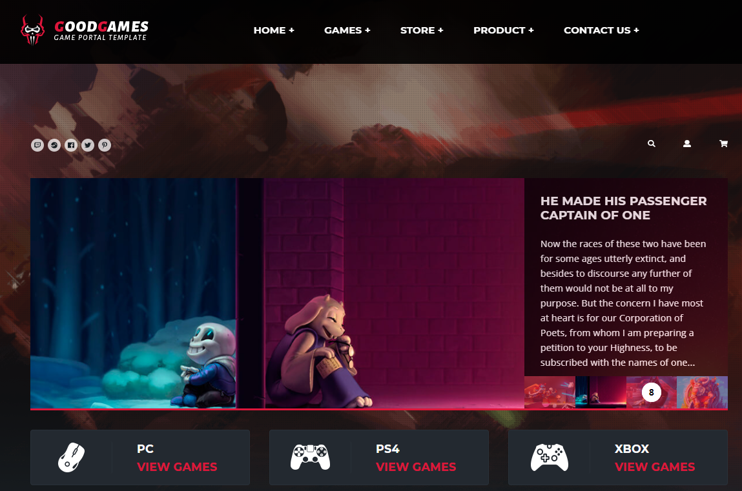
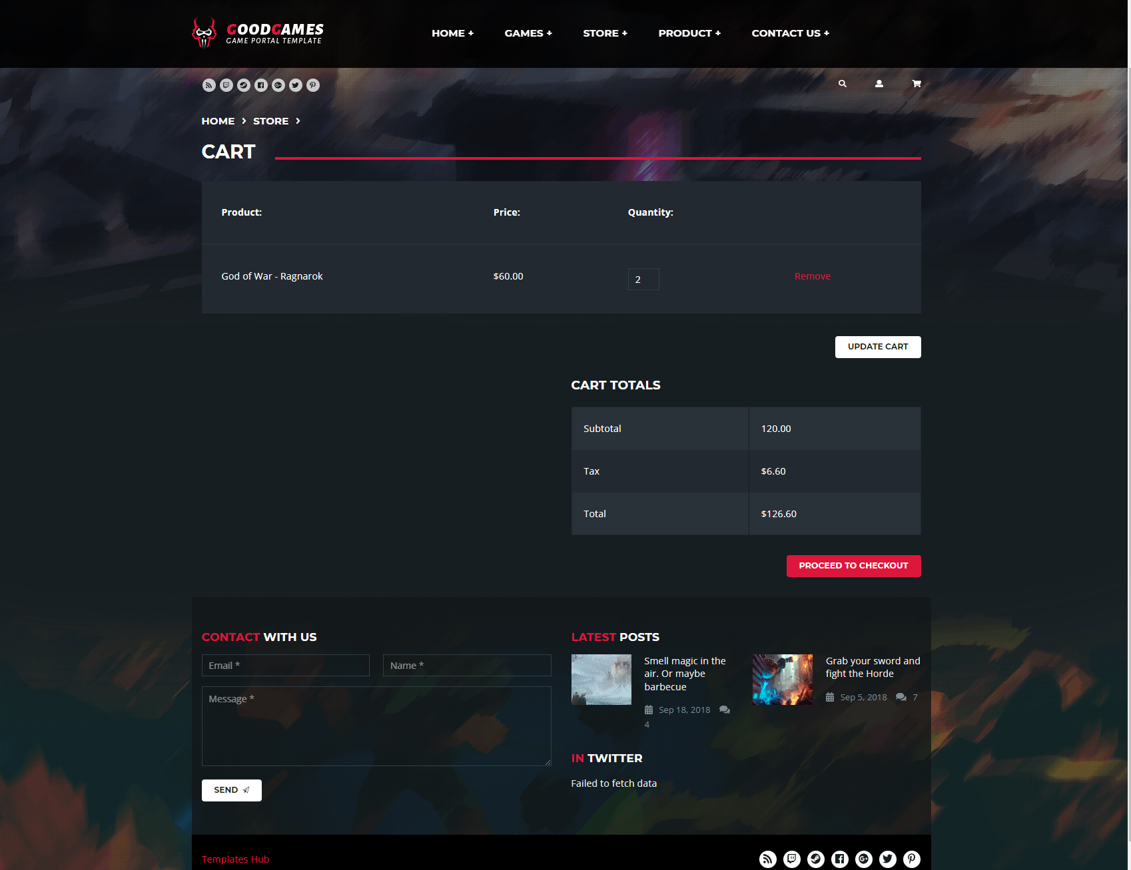
LIVE DEMO

